Slide 1



Slide 2
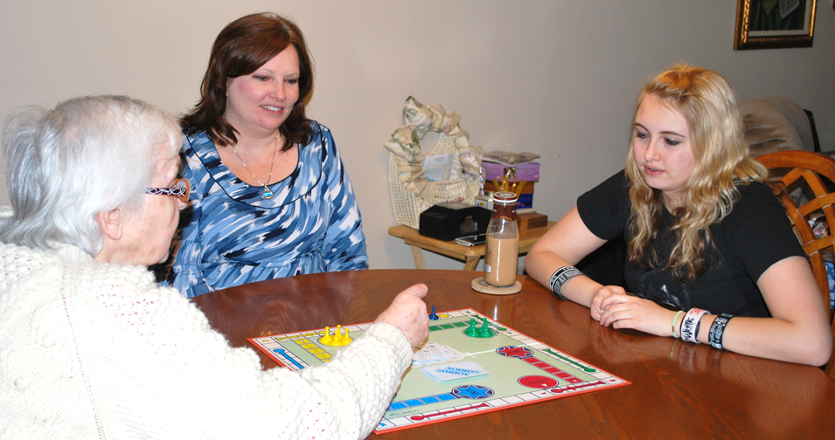
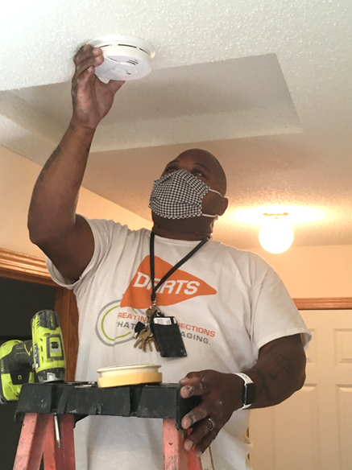

About Us
Since 1974, nonprofit DARTS has served seniors and their families in the southeast metro, helping them lead more independent lives.

Slide 3
DARTS: Mission, Vision, Values…
Mission
Create connections that enrich aging.
Vision
To be a respected leader in providing equitable solutions that reflect diverse community needs and create a fulfilling aging journey.
Values
Collaboration
Excellence
Inclusion
Responsibility
Service

Slide 4
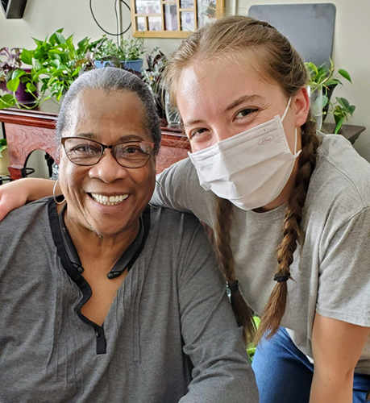

DARTS Services
Transportation
Caregiver Support
Outdoor Chore
Home Services
Volunteer Opportunities
Service Coordination

Slide 5
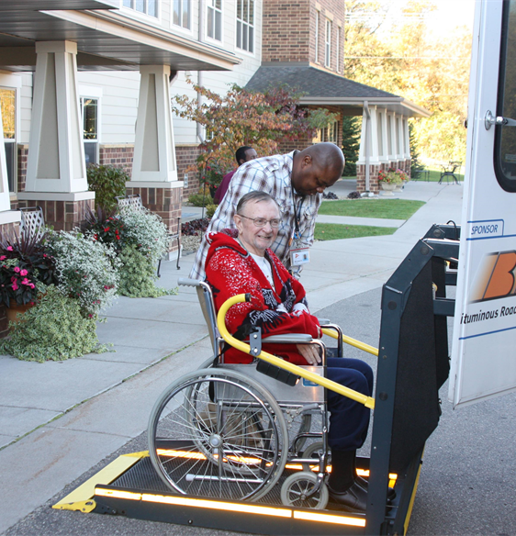
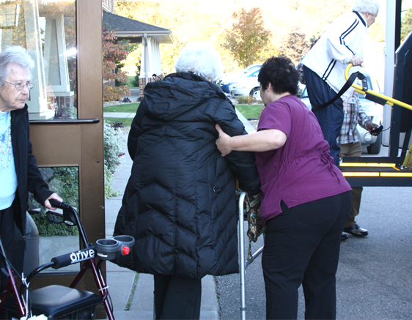
Transportation
Community LOOP
Group Rides
Individual Rides

Slide 6
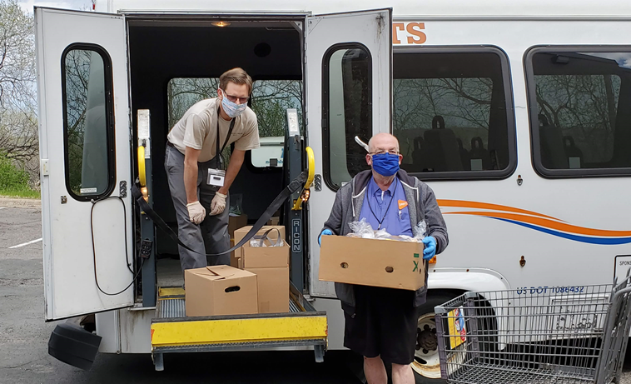
Service Coordination
Resource Referrals
Connection for Community Services
Opportunities to Combat Social Isolation

Slide 7
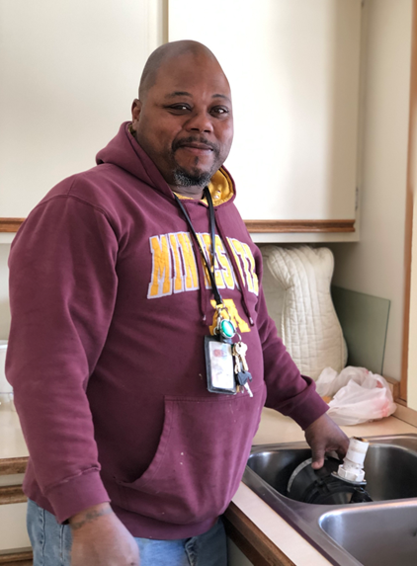
Home Services
Home Cleaning
Home Modification
Home Repairs
Outdoor Chores

Slide 8
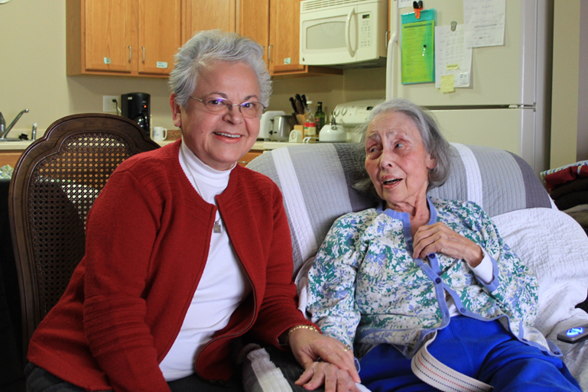
Caregiver Support
Support Groups
Coaching &
Consultation
Education
Respite

Slide 9
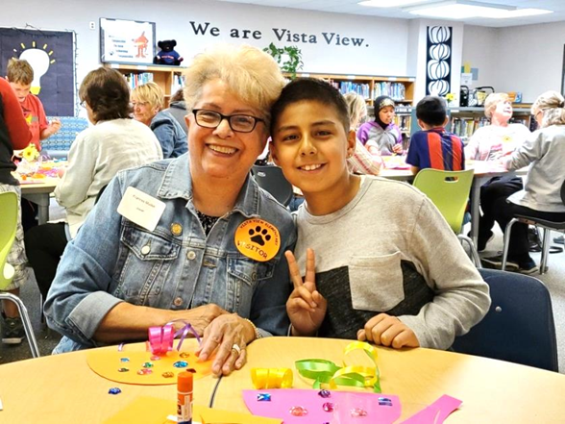
Volunteer Opportunities
Group & Individual Opportunities
Learning Buddies
Pen Pals
Outdoor Chores
Respite
Administration

Slide 10
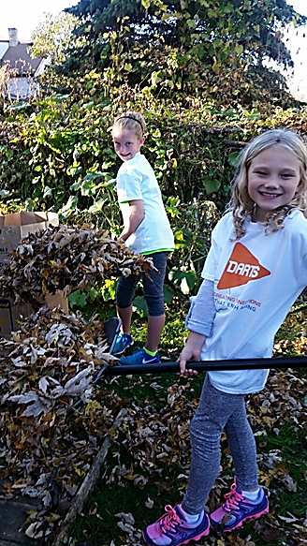
How To Get Involved
Linda Engelken
Linda.Engelken@darts1.org
651-234-2254
Erin Walloch
Erin.Walloch@darts1.org
651-234-2227
651-455-1560
info@darts1.org

Slide 11
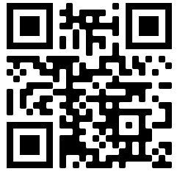

Visit us at
dartsconnects.org
Connect with us

Slide 12
Thank You!

